Slide 1
Mining PinterEst
THROUGH API DOCUMENTATION
Tatiana Ensslin | April 25th, 2016 | CSE 400

Slide 2

GOALs
Test and Average amount of pins per user’s boards
Compare pins per board to creation time
Includes
Authentication (2.0)
-Generate Token
Parse Data
Compare Data
Display Data

Slide 3

Approach
Using Pinterests API using Python/JSON
- GET Requests made pulling in token, user, board
Retrieve creation time
Retrieve amount of pins per board per user
Mine next user’s board

Slide 4
Procedure
Create functions each with an ability to request a specific piece of information
Save the returned data into variables
Create ability to pull several users/boards into a crawler to mine their pin count and board creation date using said functions
Organize data and graphically display trends (via networkx)
Show and compare (against array of users) creation time to pins per board
Recognize any trends vs board categories and pin count

Slide 5
Completed
Authentication
Authentication works with generated access token required for OAUTH 2.0
Requests
GET requests return and are converted to JSON
Parsing
Data is then parsed and saved into variables

Slide 6
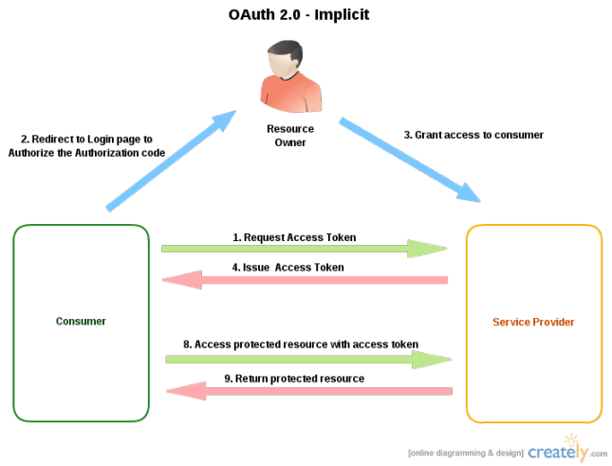
OAuth 2.0
Pinterest uses OAUTH 2.0, which requires each user to log in, including yourself in order to retrieve the access token necessary for mining.

Slide 7
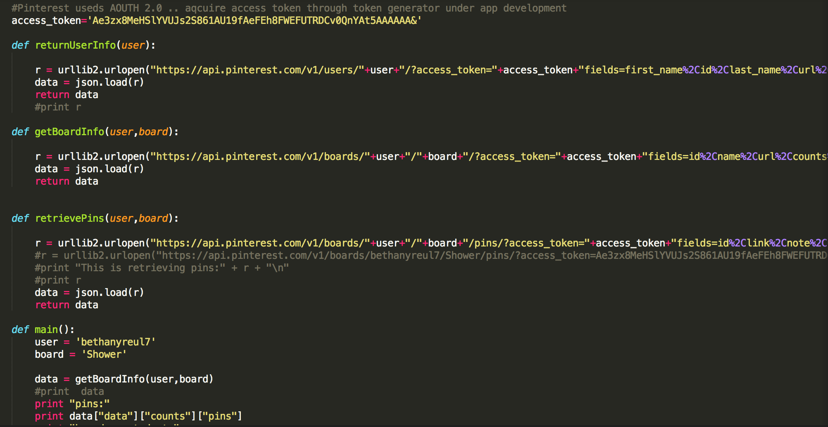
API Function Calls

Slide 8

Final thoughts
Remaining Tasks
Create potential crawler using array of usernames
Compare data to start dates and pin count
Graphically display data

